Slide 1


Agriculture IoT
Team 8corn

Slide 2
CONTENTS
Team AgIoT
Introduction
Feasibility of LoRa versus APRS in AgIoT
Smart Farm using LoRa/APRS & MQTT
QnA

Slide 3



1
Team 8Corn
Dong Jun (DJ) Kim
Kyunghee Univ.
Hye Won(Hazel) Yoon
Kyunghee Univ.
Hyuk (Brian) Lee
Handong Univ.
Woojin(Arthur) Jang
Chungang Univ.
Brandon Long
Purdue Univ.
Miran Lee
Dongguk Univ.
Chaehee(Pearl) Weon
Seoul Women’s Univ.
Gowoon(Kayla) Choi
Dongguk Univ.
Heejae(Lydia) Jung
Kyunghee Univ.
Zeeshan Khalid
Purdue Univ.
Notes:
학교는 안넣어두대나..?

Slide 4



Introduction
2
Project Background
Notes:
왜 프로젝트를 하게 됐는지?
--> 40마일 떨어진 농부가 체크하기 위해서 어쩌구저쩌구 (토니 교수님께 ppt 요청)

Slide 5
Feasibility of LoRa versus APRS in AgIoT

Slide 6
CONTENTS
Feasibility
of LoRa versus APRS
in AgIoT
Introduction
Design
Result
Conclusion
Future Works

Slide 7
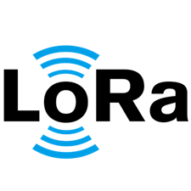
Introduction
1
LoRa and APRS
Low Power Wide Area Network (LPWAN)
Long Range
Long-range transmissions with low power consumption
( more than 10km in open area )
915 MHz
Notes:
통신속도는 LTE에 기반한 타 규격보다는 느리지만 SigFox나 Zigbee보단 빠른편 X

Slide 8

Introduction
1
LoRa and APRS
Amateur radio based system for real time
digital communications of immediate value
in the local area
Automatic Packet Reporting System
144.39 MHz

Slide 9
Introduction
1
LoRa and APRS
IoT

Slide 10
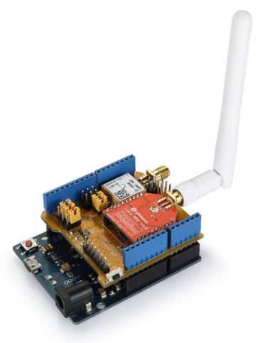
DESIGN
2
LoRa Circuit
Transmitter
Receiver

Slide 11
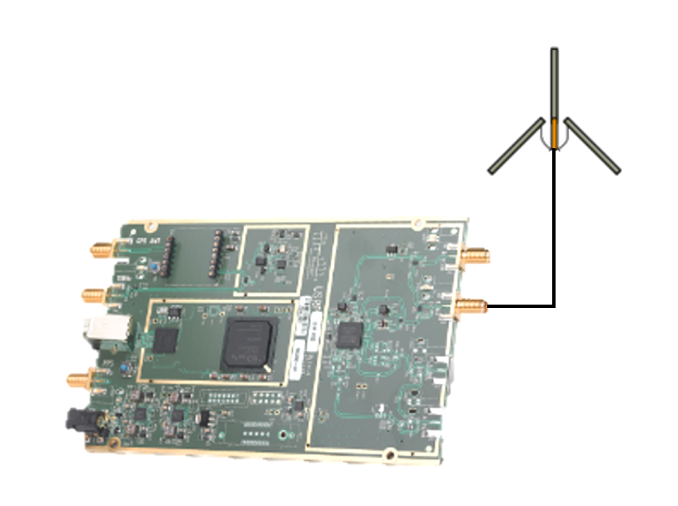
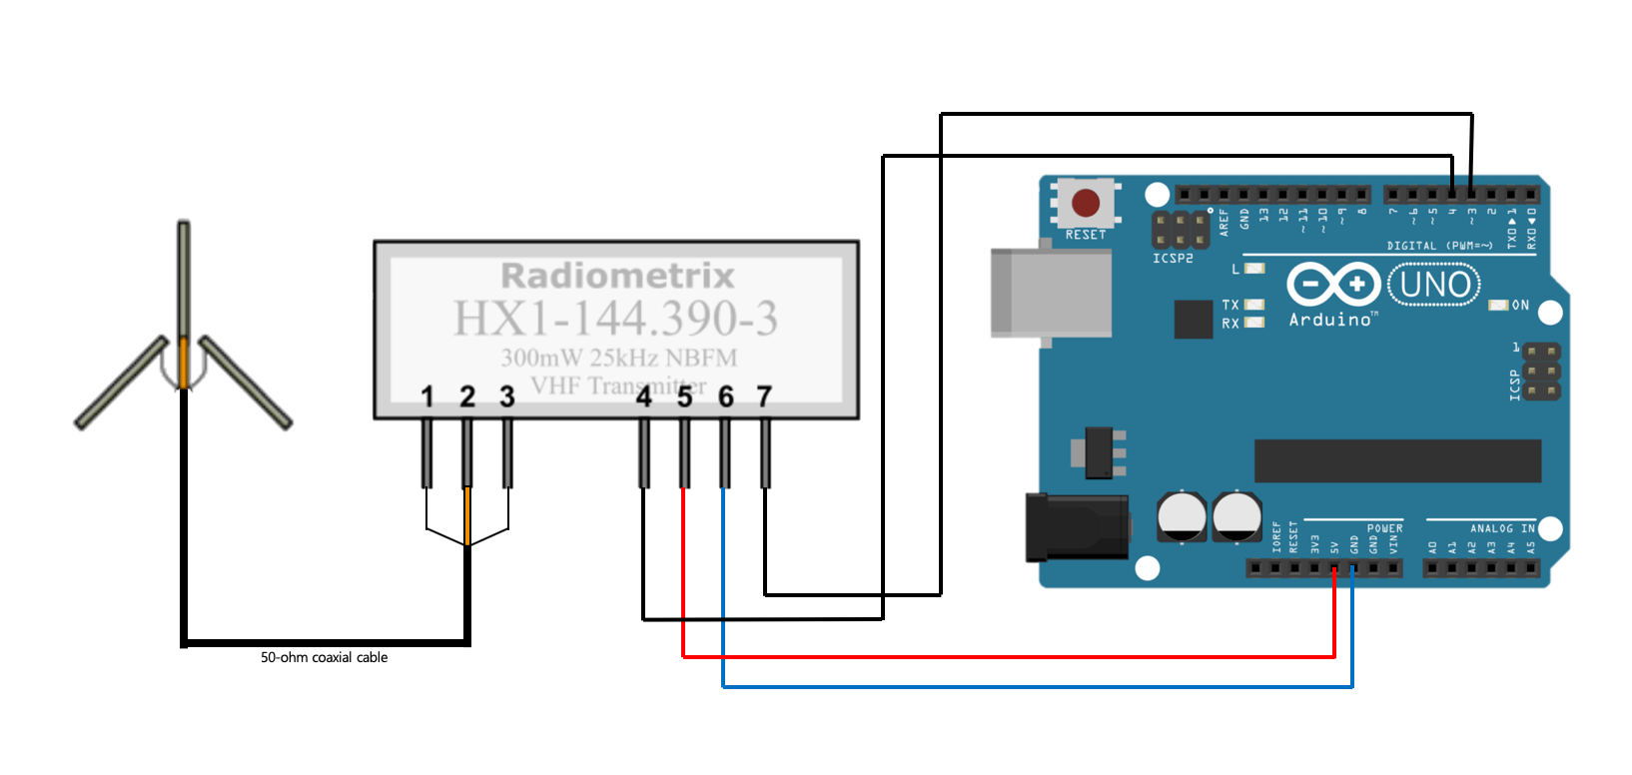

DESIGN
2
APRS
Transmitter
Receiver

Slide 12
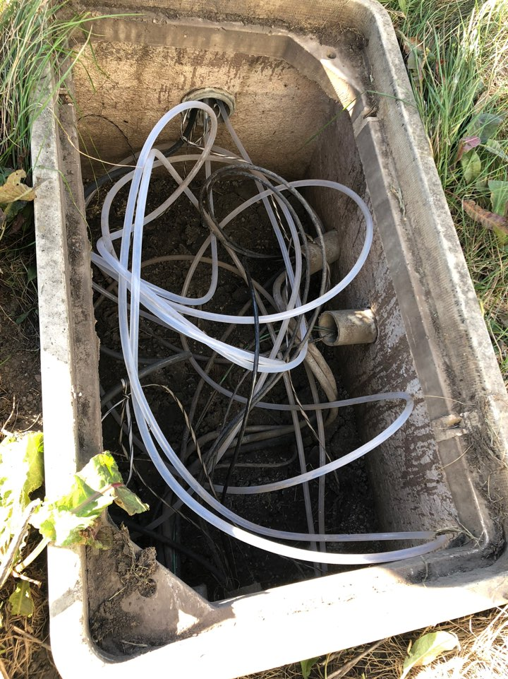
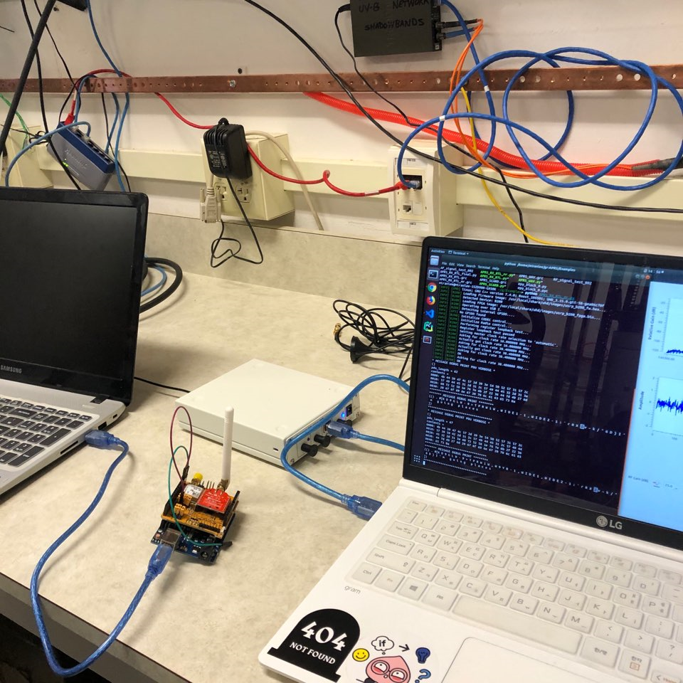
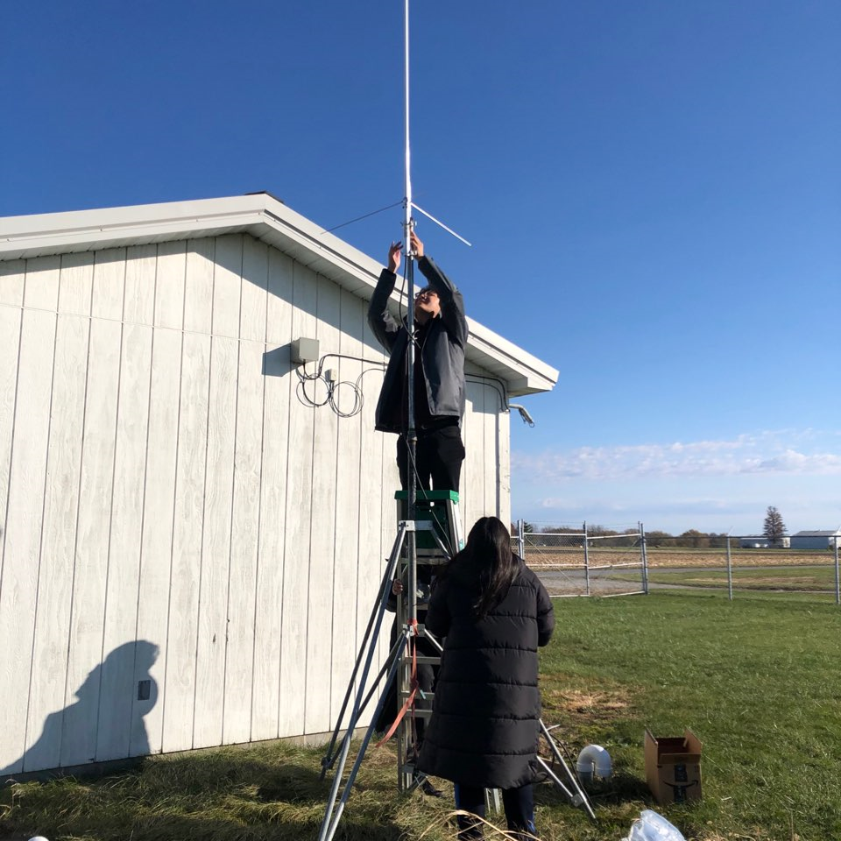
Result
3
Test

Slide 13
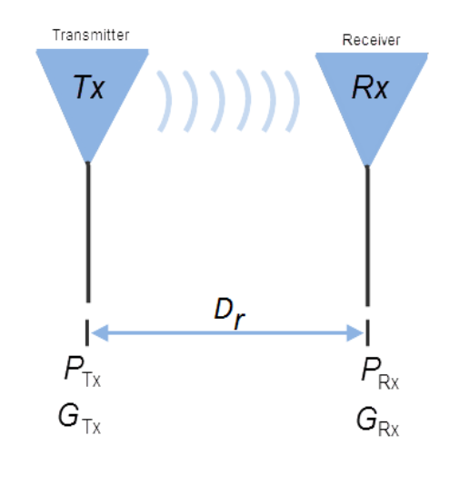
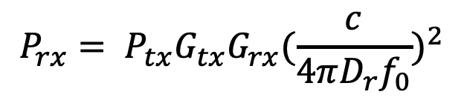
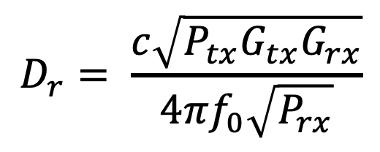
Result
3
Friis transmission equation
$$P_{rx}= P_{tx}G_{tx}G_{rx}{(\frac{c}{4πD_{r}f_{0}})}^{2}$$
$$D_{r}= \frac{c\sqrt{P_{tx}G_{tx}G_{rx}}}{4πf_{0}\sqrt{P_{rx}}}$$
Friis transmission equation

Slide 14
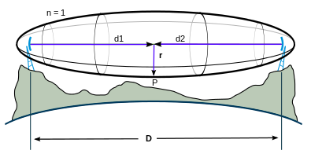
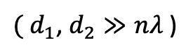
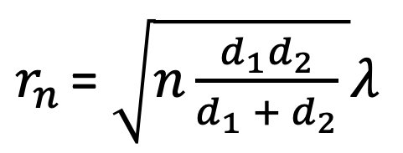
Result
3
Fresnel Zone
$r_{n }$= $\sqrt{n\frac{d_{1}d_{2}}{d_{1} + d_{2}} }λ$
${( d}_{1}$, $d_{2}≫nλ$ )
Fresnel Zone

Slide 15
Result
3
Test Result
LoRa
APRS
Transmitter Power | 16 dBm
Transmitter Gain | 9 dBi
Receiver Gain | 6 dBi
Theoretical Distance | 9.3 km ( 5.78 mile )
Height Needed | 27.79m ( 91.17 ft )
Transmitter Power | 24 dBm
Transmitter Gain | 1.17 dBi
Receiver Gain | 7 dBi
Theoretical Distance | 67.1 km ( 41.70 mile )
Height Needed | 186.58m ( 612.14 ft )
Transmitter Antenna Height | 2.1 m ( 6.89 ft )
Receiver Antenna Height | 2.7 m ( 8.86 ft )
Tested Distance | 4.2 km ( 2.6 mile )
Efficiency Constrained by Height | 45.16%
Transmitter Antenna Height | 2.1 m ( 6.89 ft )
Receiver Antenna Height | 3.2 m ( 10.50 ft )
Tested Distance | 0.84 km ( 0.52 mile )
Efficiency Constrained by Height | 1.25%
“
“
for distance 4.2 km
antenna height should be 18.67m
for distance 0.84 km
antenna height should be 20.88m
“
“
Notes:
theoretical height needed
efficiency constrained by height

Slide 16
Conclusion
4
Limitation and Conclusion
//
67km
186m
Transmitter and Receiver place 186m height for 67km coverage distance
by Fresnel Zone

Slide 17
Future Works
5
APRS and LoRa
Test LoRa and APRS distance coverage with same gain antennas
Install antennas on taller structure and test

Slide 18
Smart Farm using LoRa/APRS & MQTT

Slide 19
CONTENTS
Smart Farm using
LoRa/APRS & MQTT
Introduction
Design
Data & Algorithm
Result
Future Works

Slide 20
Introduction
1
Our Part
Key Factors of Smart Farm:
1. Low-cost
2. Low power consumption
3. High convenience for management
4. Lightweight messaging protocol
5. High reliability
Notes:
There are several studies on suggesting LoRa as the networking technology for smart farms.

Slide 21

Introduction
1
MQTT
“
MQTT is a machine-to-machine (M2M)/"Internet of Things" connectivity protocol.
It was designed as an extremely lightweight publish/subscribe messaging transport.
It is useful for connections with remote locations where a small code footprint is required and/or network bandwidth is at a premium.
“
Notes:
통신속도는 LTE에 기반한 타 규격보다는 느리지만 SigFox나 Zigbee보단 빠른편 X

Slide 22
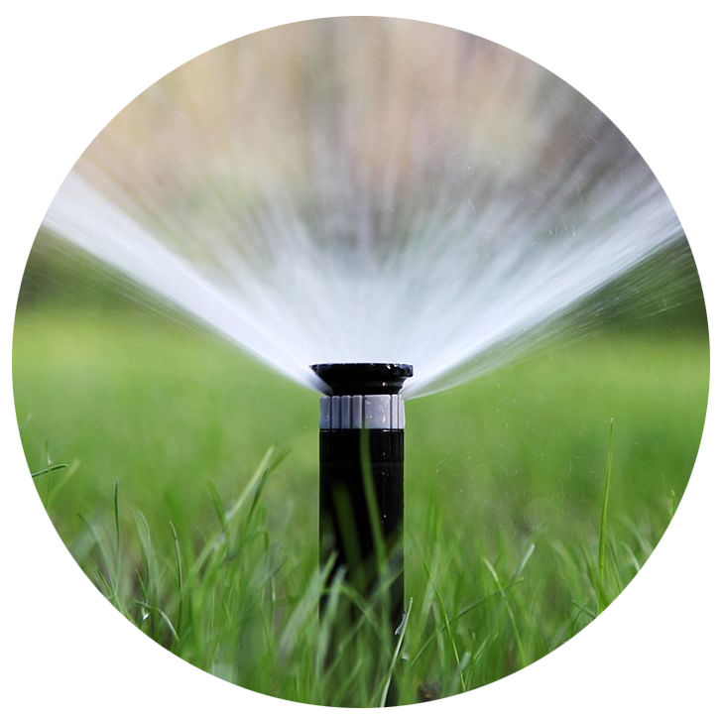
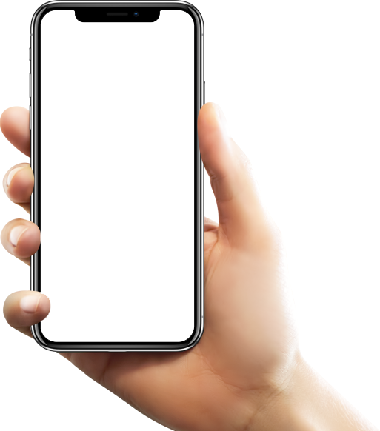
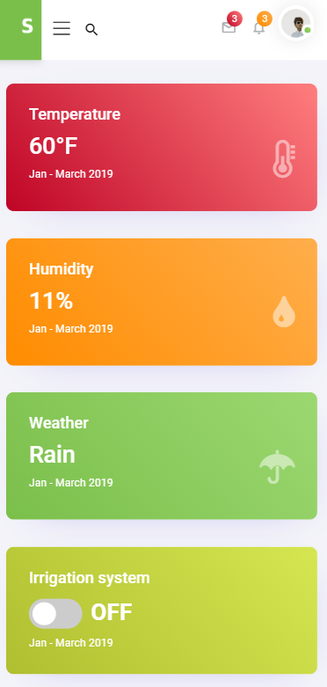
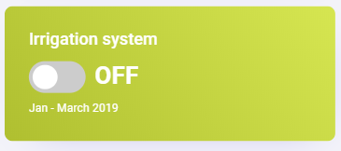
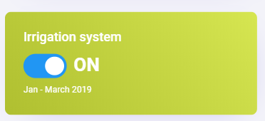
Introduction
1
Irrigation System
Our Part
: Use wireless to control the sprinklers

Slide 23
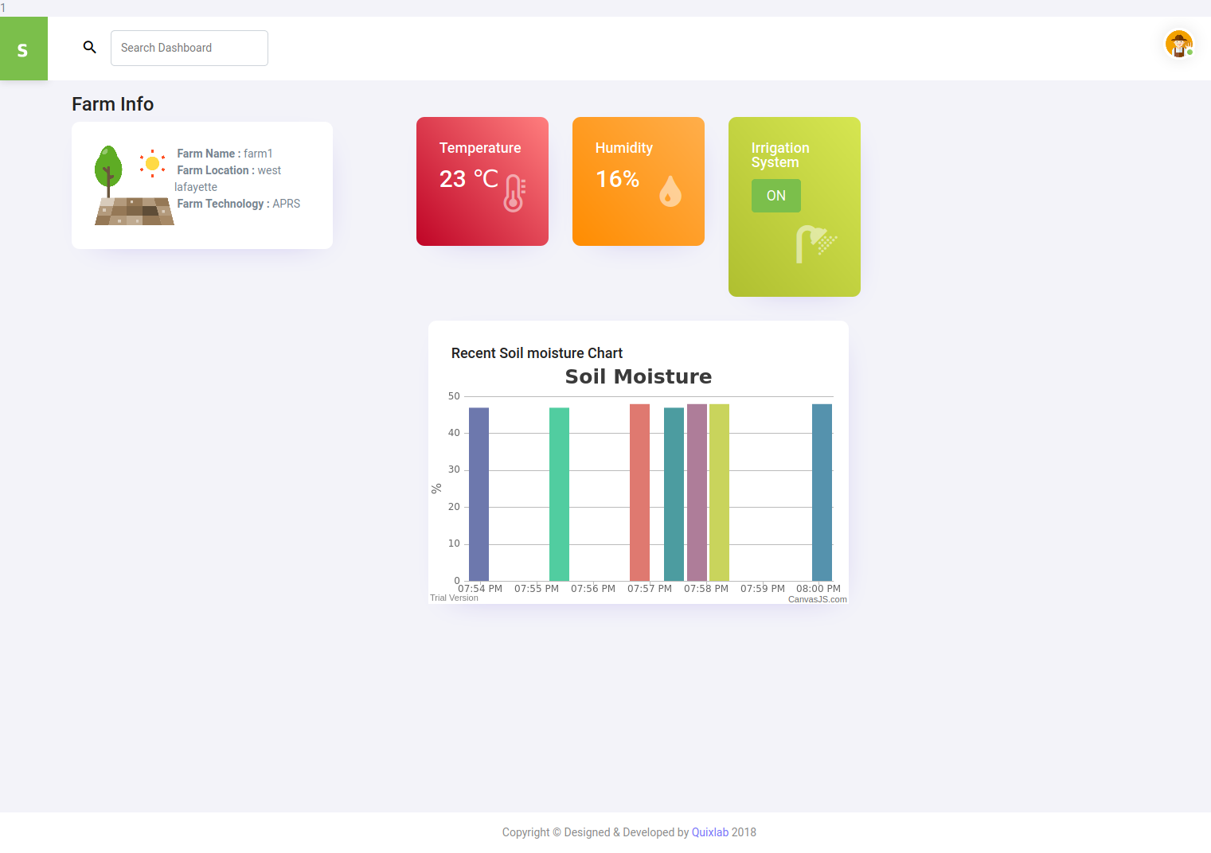
Introduction
1
Our Part
Smart Farm Web Interface
: Checking the status of the farm

Slide 24
DESIGN
2
LoRa Try
Use only edge computing without using cloud
Use MQTT sn over LoRa communication
Send packets by using UDP to TTN(Cloud) & use edge computing
Use LoRa and MQTT separately

Slide 25
DESIGN
2
APRS Try
Build APRS Transmitter with Raspberry Pi and HX1
Use MQTT on APRS network
Connect APRS Transmitter using Arduino and HX1 to Raspberry Pi
Use APRS and MQTT separately
Notes:
hx1 raspberry pi 위에 올리는 거 실패해서, 아두이노랑 라파 연결함

Slide 26
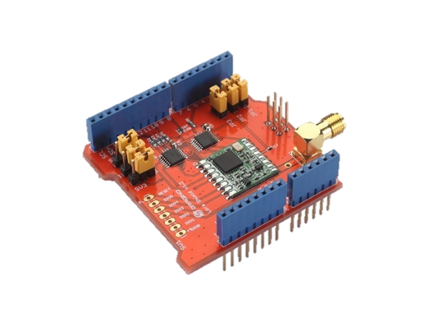
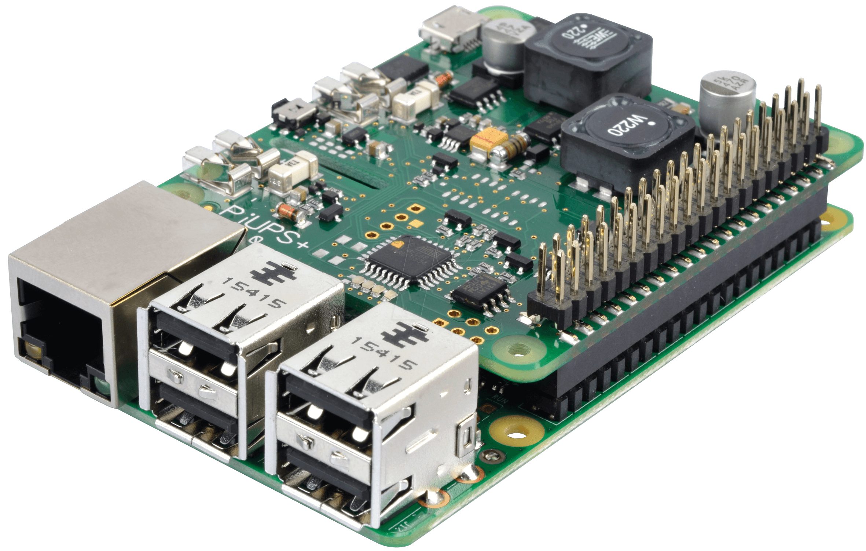
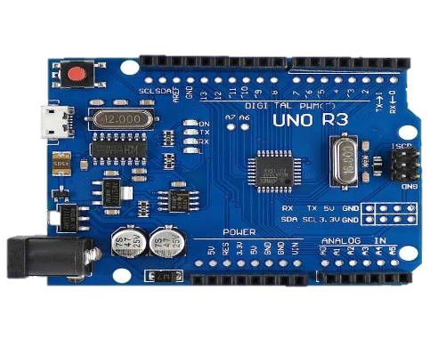
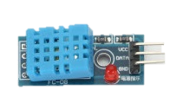
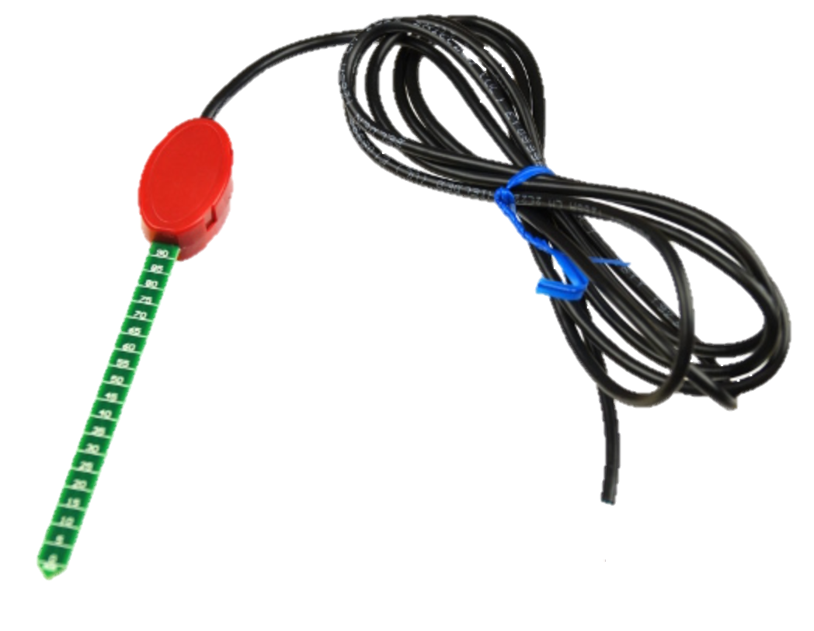
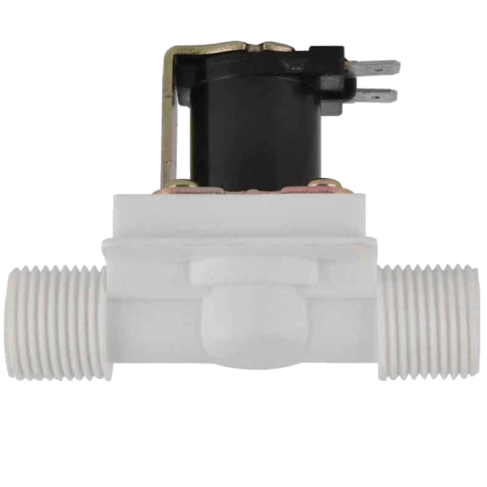
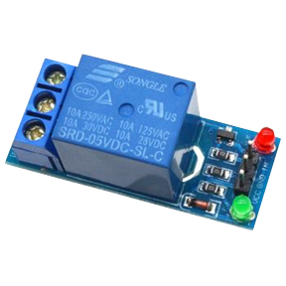
DESIGN
2
LoRa Hardware
Raspberry pi
LoRa Shield
Arduino Uno
Temp & Humidity Sensor
Soil Humidity Sensor
Solenoid valve
High level trigger

Slide 27
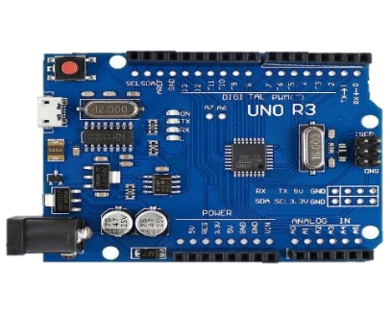
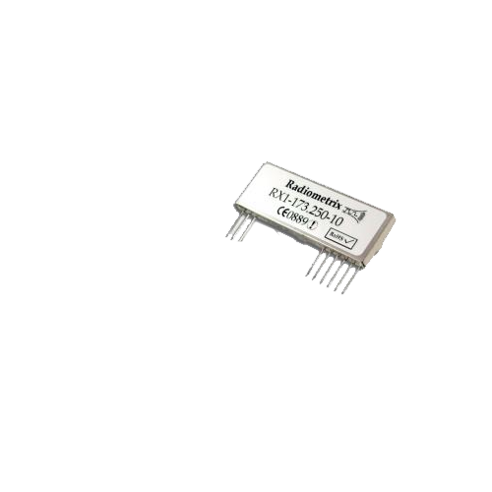
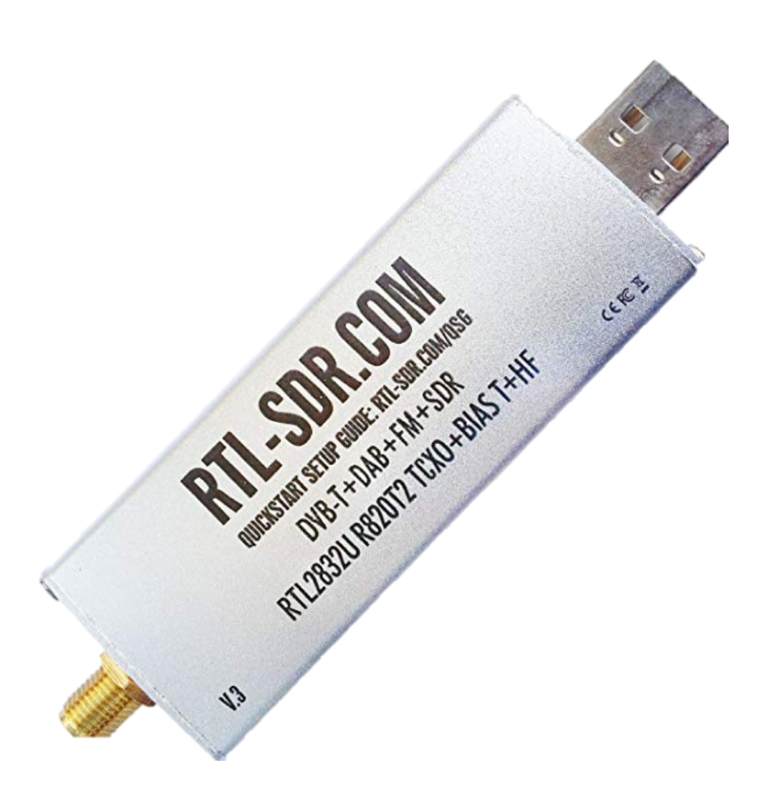
DESIGN
2
APRS Hardware
Raspberry pi
Arduino Uno
HX1 transmitter
RTL SDR dongle
Temp & Humidity Sensor
Soil Humidity Sensor
Solenoid valve
High level trigger

Slide 28




DESIGN
2
LoRa Software

Slide 29

DESIGN
2
APRS Software

Slide 30
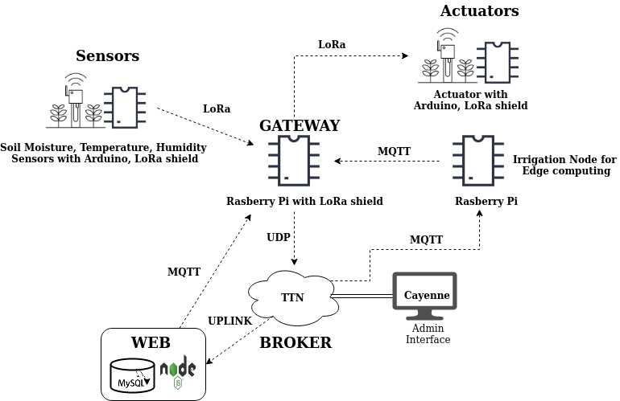
DESIGN
2
LoRa Diagram
admin

Slide 31
DESIGN
2
LoRa Diagram

Slide 32
DESIGN
2
LoRa Diagram

Slide 33
DESIGN
2
LoRa Diagram

Slide 34
DESIGN
2
LoRa Diagram

Slide 35
DESIGN
2
LoRa Diagram

Slide 36
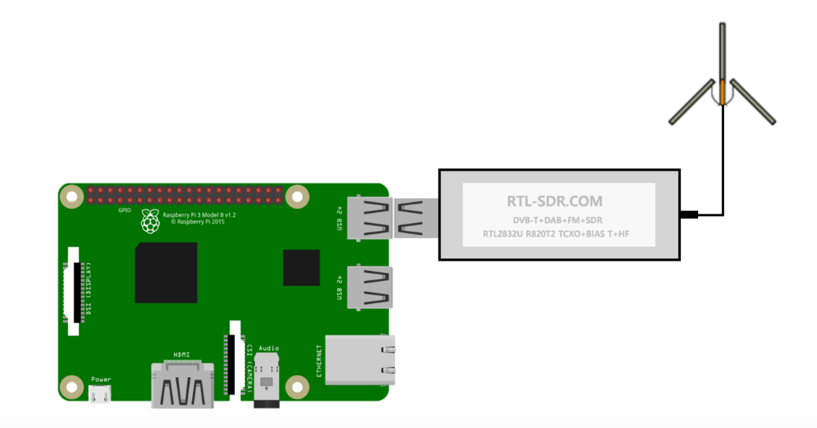
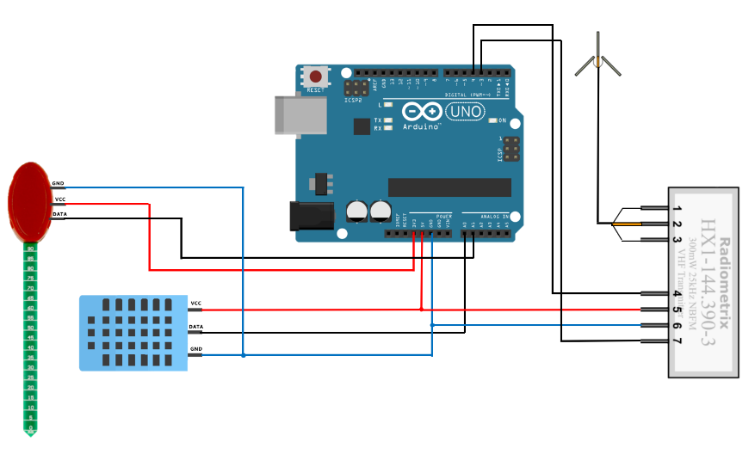
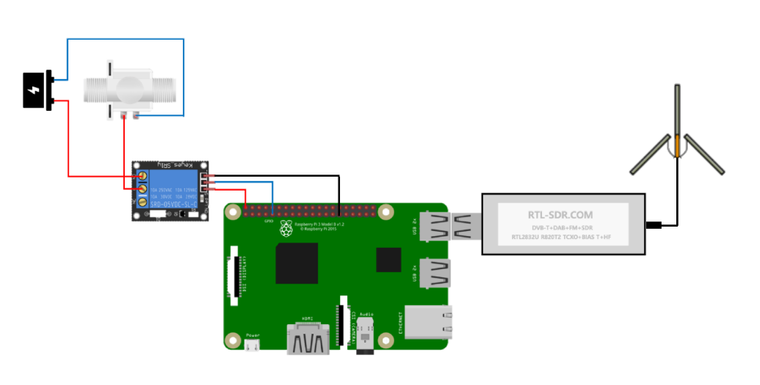
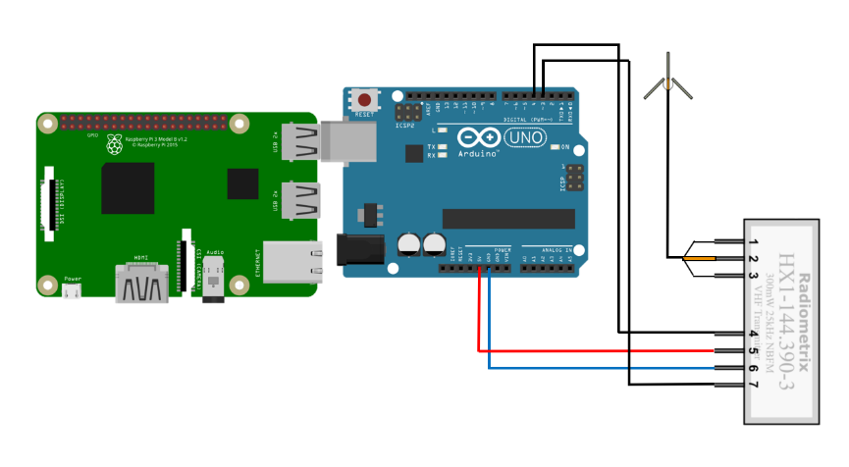
DESIGN
2
APRS Node Circuit
Node1 – Sensor Package
Node2 – GATEWAY
APRS Transmitter
APRS Receiver & MQTT Publisher
Node3 – BROKER
Node4 – Actuator
MQTT Broker & MQTT Subscriber & APRS Transmitter
APRS Receiver
Notes:
로라도 저 회로도 받아서 추가하깅

Slide 37
DESIGN
2
APRS Diagram

Slide 38
DESIGN
2
APRS Diagram

Slide 39
DESIGN
2
APRS Diagram

Slide 40

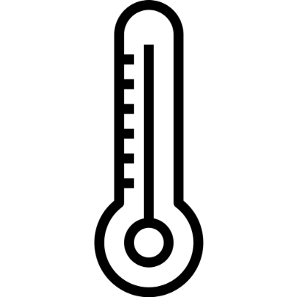
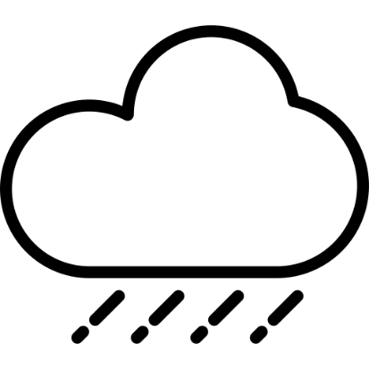

Data & Algorithm
3
Collected Data
Humidity
Temperature
Weather
Soil moisture

Slide 41
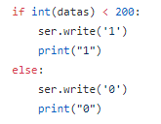
Data & Algorithm
3
Algorithm
Soil Moisture Data
MIN: 0 MAX : 696

Slide 42
Result
3
LoRa Demo

Slide 43
Result
3
APRS Demo

Slide 44
Future Works
5
LoRa
Build without the Internet
Internet is Needed
Edge Logic is determined only by the Farmer’s manual decision and Soil Moisture
No monitoring system for sensors and nodes
Increase the accuracy of the weather prediction
Make sensor monitoring system
Ex) sensor malfunction, battery consumption …

Slide 45
Future Works
5
APRS
Build without the Internet
Build APRS transmitter with Raspberry Pi and HX1
Control multi node
> using GPS
> meaning of Broker

Slide 46
QnA

Slide 47
Thank You !

